Slide 1


15 September 2026
Project Phase-I Review-I
15 September 2026
Paper Title: A Bidirectional Deep Learning Framework for Real-Time Sign Language to Text and Text to Sign Translation
Presented by:
Mr. Md Bilal Uddin (160923737027)
Mr. Mohd Safwaan (160923737034)
Mr. Mohammed Ubaid Ur Rahman Siddiqui (160923737041)
Under the Guidance of
Mrs. B Swaroopa,Assistant Professor
Department of IT, Lords Institute of Engineering and Technology, (Autonomous), Hyderabad –Telangana -India

Slide 2
OUTLINES
15 September 2026
Introduction
Problem Statement
Literature Review
Research Methodology
Expected Result And Evaluation
Conclusion
References (Base Papers)
Department of IT, Lords Institute of Engineering and Technology, (Autonomous), Hyderabad –Telangana -India

Slide 3
15 September 2026
Introduction
Sign Language Input – Captures sign gestures through webcam/video and sends them to the system.
Transformer-Based Translation – Processes the captured gestures and performs sign-to-text and text-to-sign translation.
Output & Display – Displays the predicted text and corresponding sign images, enabling two-way communication.
Department of IT, Lords Institute of Engineering and Technology, (Autonomous), Hyderabad –Telangana -India

Slide 4
Problem Statement
15 September 2026
• Traditional sign language translation is manual and difficult, creating communication barriers
• Need real-time translation between sign gestures and text for effective two-way communication
• Objective: Develop a Transformer-based model to translate signs to text and text back to signs
Department of IT, Lords Institute of Engineering and Technology, (Autonomous), Hyderabad –Telangana -India

Slide 5
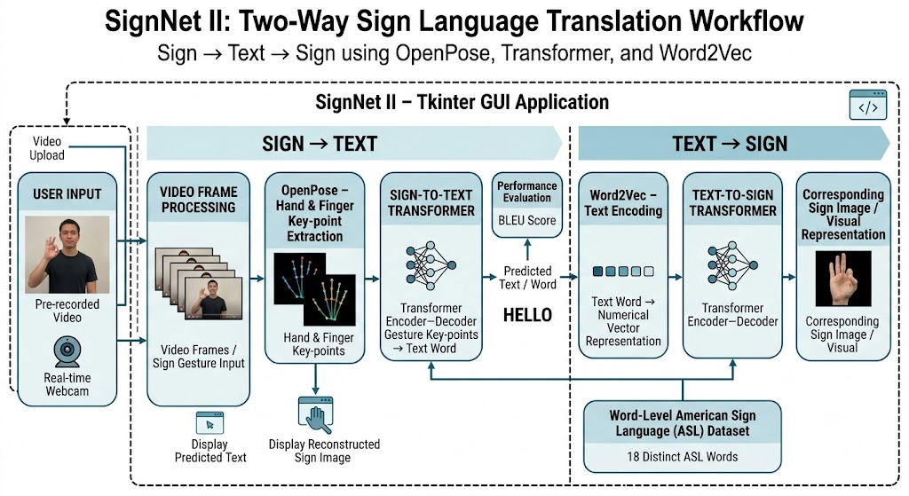
15 September 2026
Camgöz, N.C., Koller, O., Hadfield, S. and Bowden, R., 2020. Sign Language Transformers: Joint End-to-End Sign Language Recognition and Translation. Proceedings of the IEEE/CVF Conference on Computer Vision and Pattern Recognition (CVPR).
Department of IT, Lords Institute of Engineering and Technology, (Autonomous), Hyderabad –Telangana -India

Slide 6
Dataset Description
15 September 2026
Source: Word-level American Sign Language (ASL) dataset used for training the SignNet II translation models.
• Dataset: American Sign Language (ASL) Word-Level Dataset
• Records: 18 distinct ASL words
• Key Features: Video-based sign gestures, hand and finger key-points extracted using OpenPose, and corresponding textual word labels
• Target: ASL Sign → Text Word → Corresponding Sign Image/Visual
Department of IT, Lords Institute of Engineering and Technology, (Autonomous), Hyderabad –Telangana -India

Slide 7
15 September 2026
Methodology / Approach
• Data Preprocessing & Feature Extraction
OpenPose-based hand and finger key-point extraction
• Train Transformer Models:
Sign-to-Text Transformer
Text-to-Sign Transformer
• Two-Way Translation & Model Evaluation
Sign → Text → Sign Image
BLEU Score Evaluation
Department of IT, Lords Institute of Engineering and Technology, (Autonomous), Hyderabad –Telangana -India

Slide 8
Conclusion
15 September 2026
SignNet II enables two-way sign language translation using OpenPose and Transformer models, providing an interactive and accessible communication solution.
The system offers real-time interaction through a Tkinter GUI and evaluates translation using the BLEU score.
Department of IT, Lords Institute of Engineering and Technology, (Autonomous), Hyderabad –Telangana -India

Slide 9
15 September 2026
Thank You…
Department of IT, Lords Institute of Engineering and Technology, (Autonomous), Hyderabad –Telangana -India

Slide 10
References
15 September 2026
P. Muschik, A. Duarte, and X. Giró-i-Nieto, “Learn2Sign: Sign Language Recognition and Translation Using Human Keypoint Estimation and Transformer Model,” 2020.
N. C. Camgöz, O. Koller, S. Hadfield, and R. Bowden, “Sign Language Transformers: Joint End-to-End Sign Language Recognition and Translation,” Proceedings of the IEEE/CVF Conference on Computer Vision and Pattern Recognition (CVPR), pp. 10023–10033, 2020.
N. C. Camgöz, S. Koller, S. Hadfield, and R. Bowden, “Deep Learning Methods for Sign Language Translation,” ACM Transactions on Accessible Computing, 2021.
Department of IT, Lords Institute of Engineering and Technology, (Autonomous), Hyderabad –Telangana -India

